Slide 1


FIELD BOOKING SYSTEM
Group 9
Group Members:
Mohammed Adil (415006855)
Osama Ahmad (764000269)
Araz Hafez (433006827)
Muhammed Rashid (421007820)

Slide 2

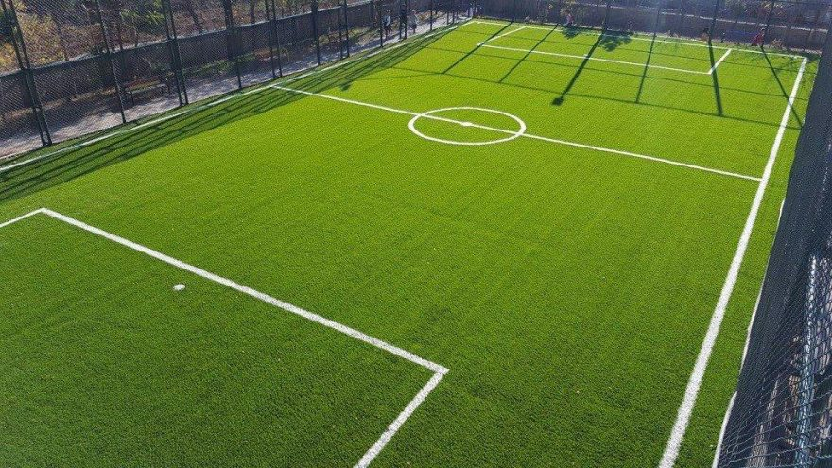

What Is our idea?
Our idea is to build a Digital Field Booking System called FieldReserve.
FieldReserve is a web-based application that allows sports enthusiasts and community groups to browse available sports fields and submit booking requests in a simple and conflict-free way.
Unlike complex scheduling platforms or phone calls, our system focuses on:
Simplified reservations
Clear field availability
Persistent user selections
The goal is to provide a safe, easy-to-use, and efficient solution for managing community sports field reservations.

Slide 3
How Will It Work?
Users browse available sports fields through a simple web interface
Availability is displayed automatically based on existing bookings
Users submit booking requests with selected date and field
The system validates requests and prevents basic conflicts
Send confirmation email to the user including date and time of the booking

